Slide 1
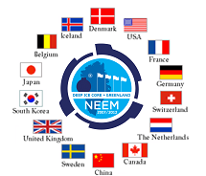



A comprehensive study of the NEEM basal ice build-up using a multi parametric approach
Goossens Thomas
Célia Sapart
Saïda El Amri
Trevor Popp
Jean-Louis Tison

Slide 2
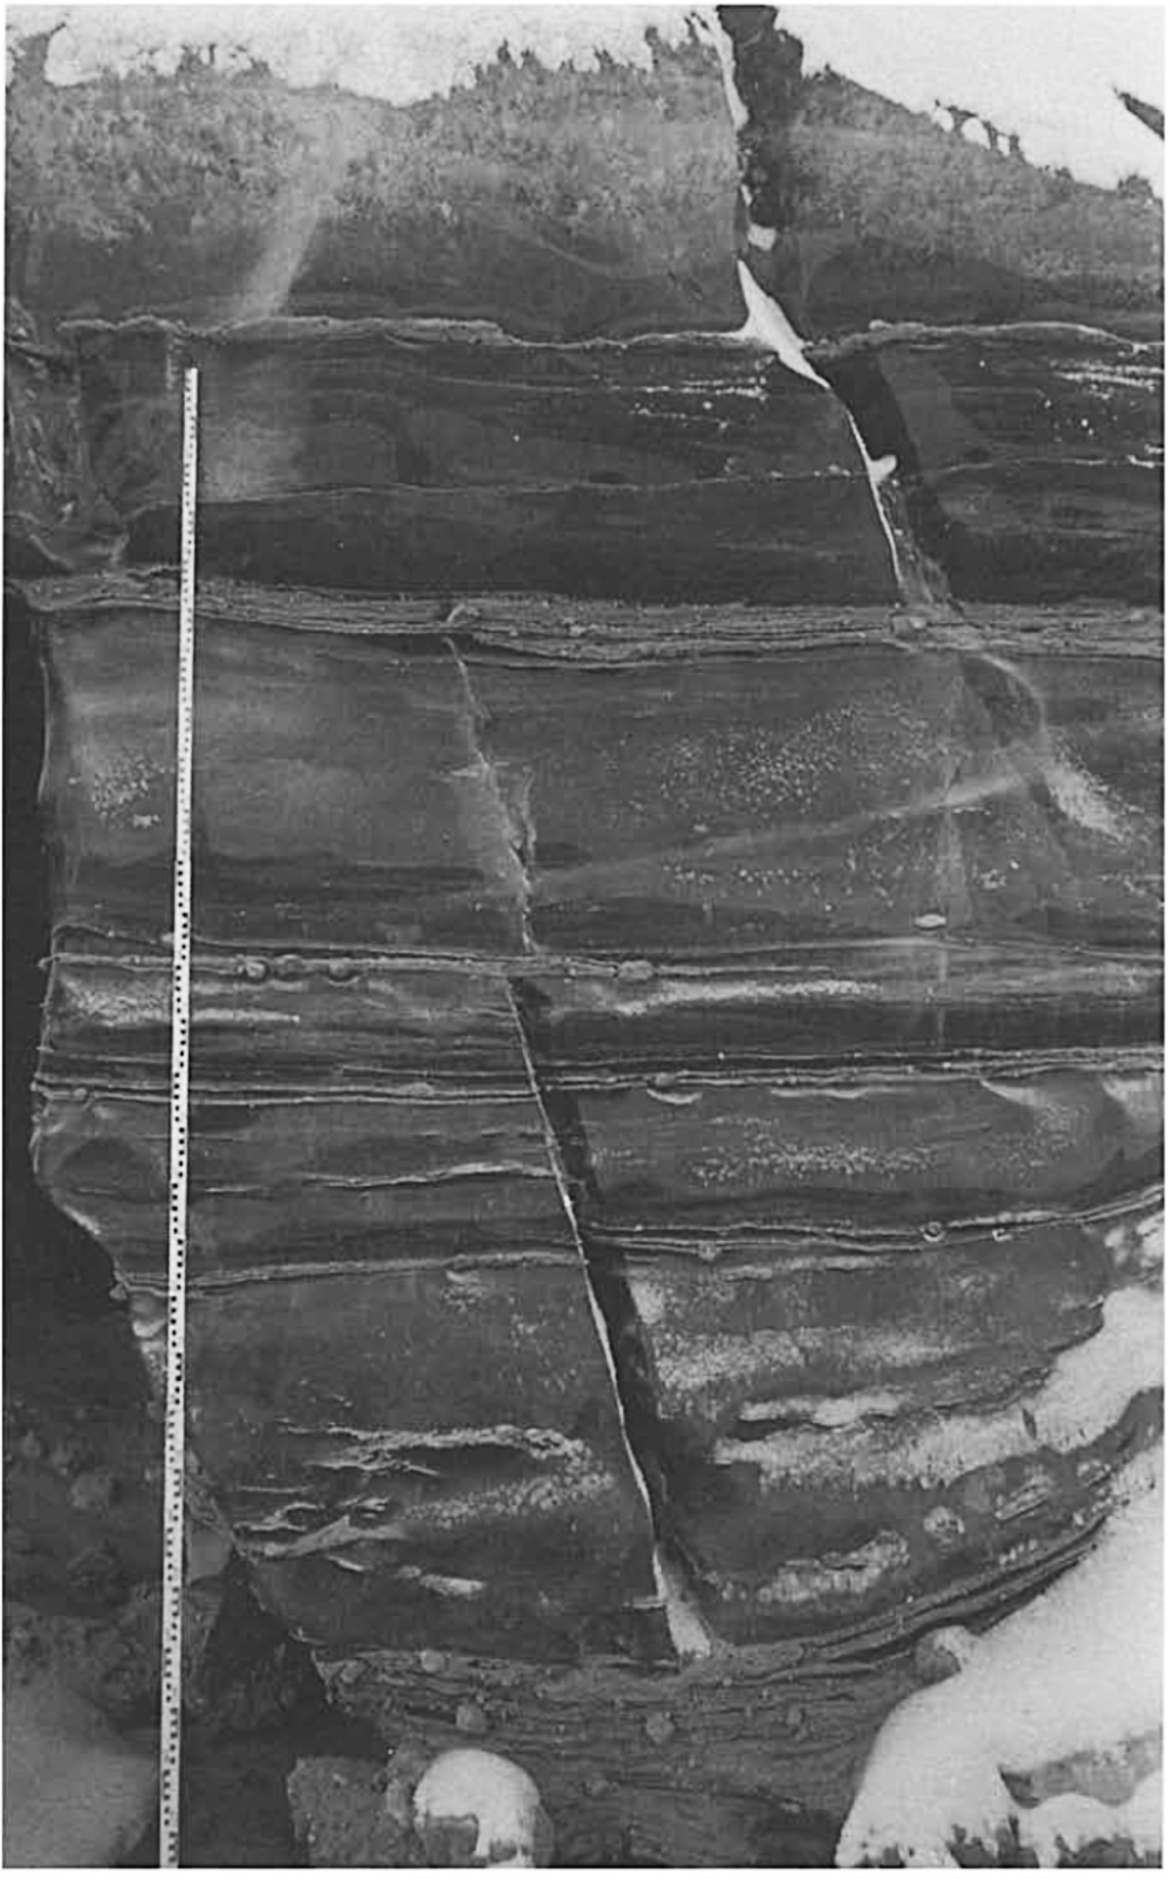
1. Context & Motivations – Basal Ice importance ?
Basal Ice layer (BIL) =
debris bearing deep ice
Particular Rheology
Knight 1997
Key questions about basal ice
Impact on ice sheet flow and consequence for sea level rise ?
Formation processes alter paleoclimatic signals ?

Slide 3
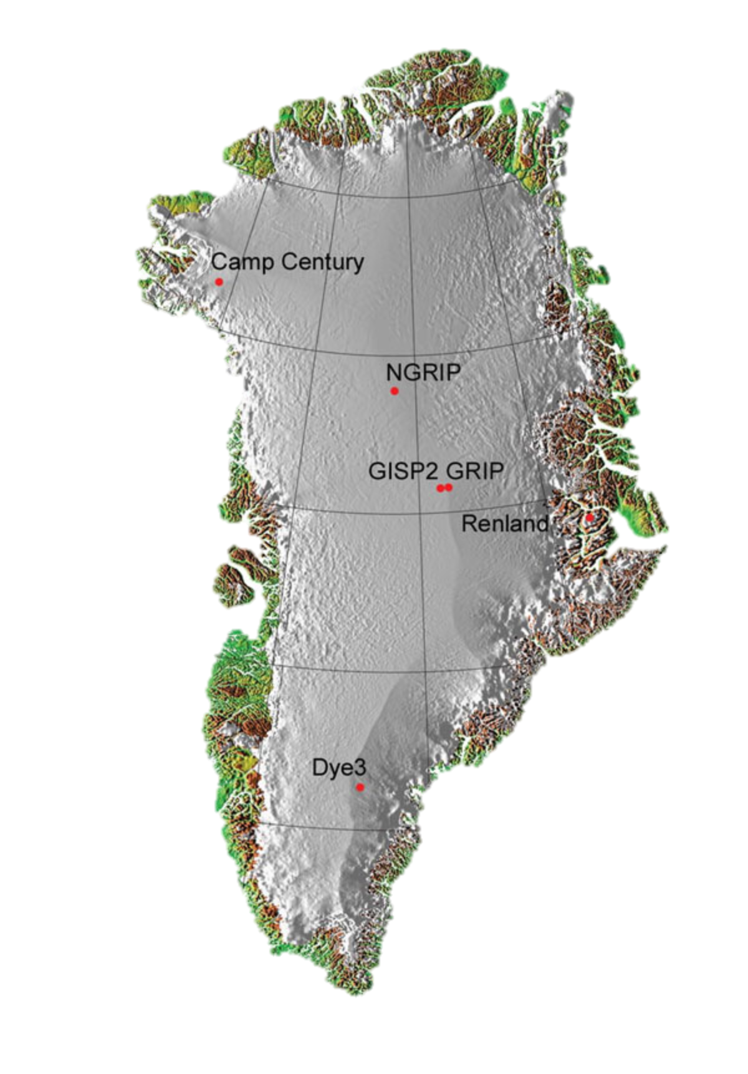
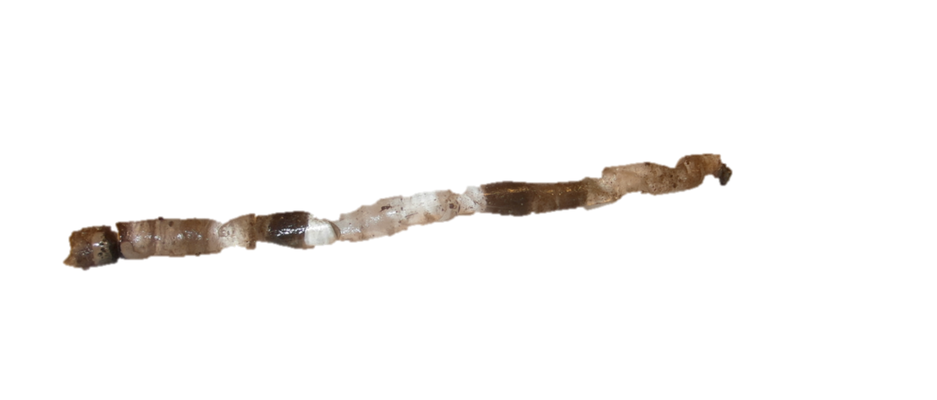
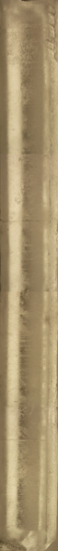
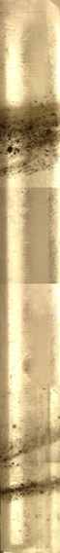
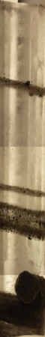
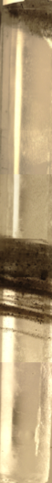
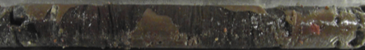
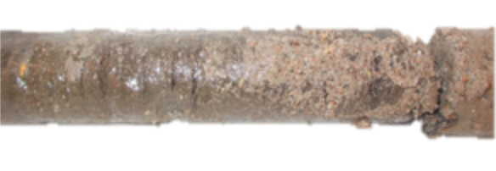
3. NEEM : a new opportunity of BIL characterization
2010-2011
4.14 m L - 110 mm ∅
2012
5.85 m L - 30 mm ∅
NEEM
Samples of Rock drill Basal ice cores
Hans Tausen Basal ice core
NEEM core location
Contribution of the present work :
Processes responsible for the build up ?
Inferences about basal conditions?
Altered paleoclimate signal?

Slide 4
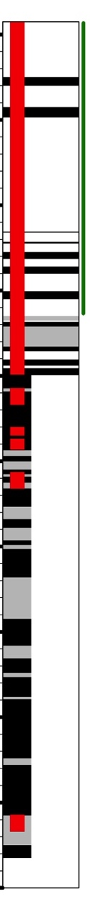
4. Three visually contrasting ice types
Sampled segments
CIS
DRL
IDD
Pure shear
Simple Shear

Slide 5
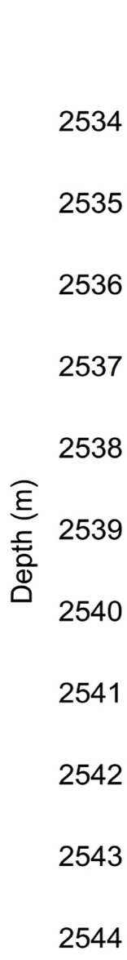
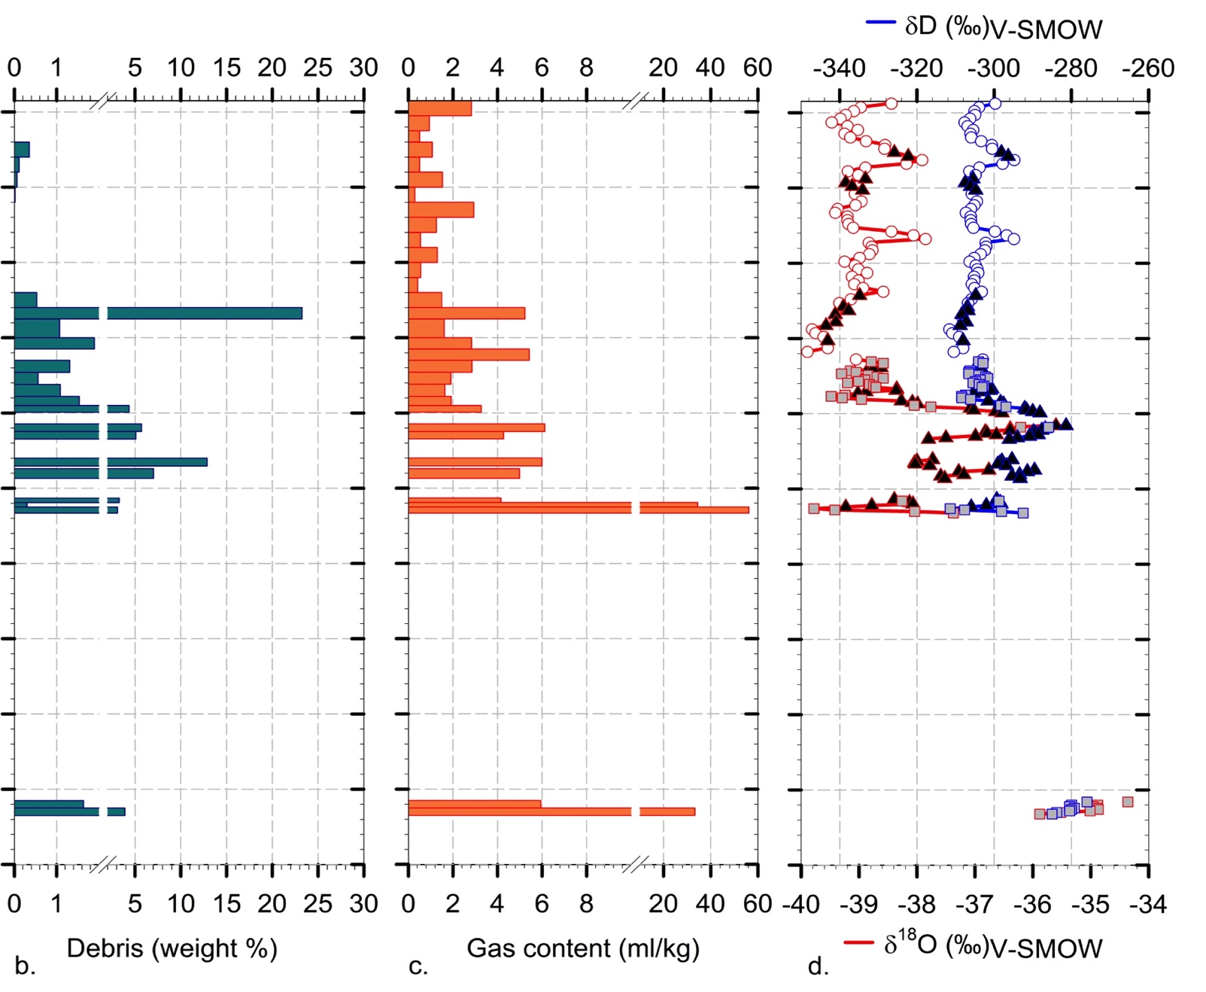
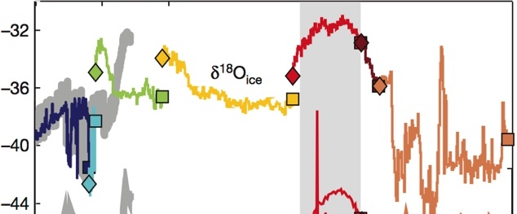
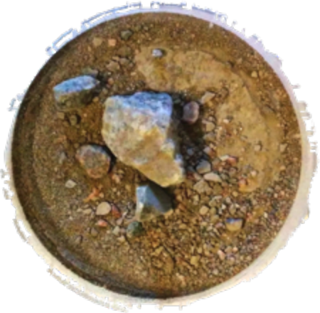
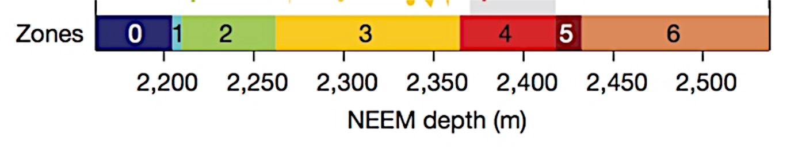
5. Information from measurements ?
Mean 2.47 % higher than previous cores
pebbles eolian origin
Content increasing downwards
Mean 6 mlkg⁻¹ lower than previous cores
Below normal ice sheet values ca. 90 mlkg⁻¹
Highest values bottom
Mean -38.87 % ➔ existent ice sheet
In the range of last 300 m
Dahl Jensen et al. 2013
Heavier = bottom IDD
DEBRIS
GAS
ISOTOPES

Slide 6
7. Is Melting/refreezing involved ? The freezing slope concept
Jouzel and Souchez Model
MWL (S = 8)
W_{inp}
δD
W_{res}
Freezing slope
Closed system
Freezing slope
Open system
Light (+ neg)
Heavy (- neg)
Theoretical plot
δ¹⁸O
External Water Input (A)
CLOSED
Initial Water (W_{i})
OPEN
Initial Water (W_{i})
Freezing (F)
Freezing (F)
Refrozen ice
Refrozen ice

Slide 7
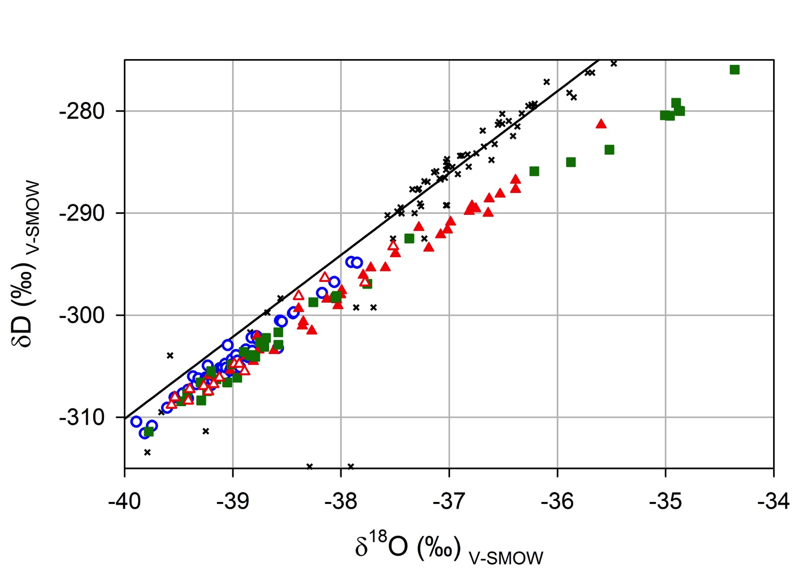
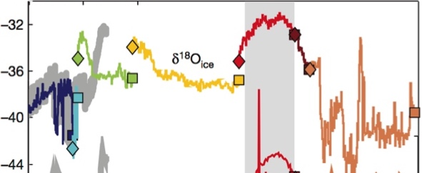
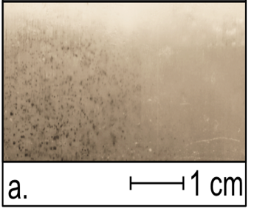
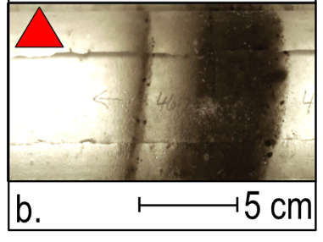
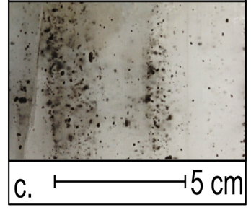
8. Tracking of M/R events @ NEEM BIL
Last 300 m
Slope = 8.02 ➔ Meteoric
CIS
DRL
IDD
Slope = 7.93
➔Meteoric ✔

Slide 8
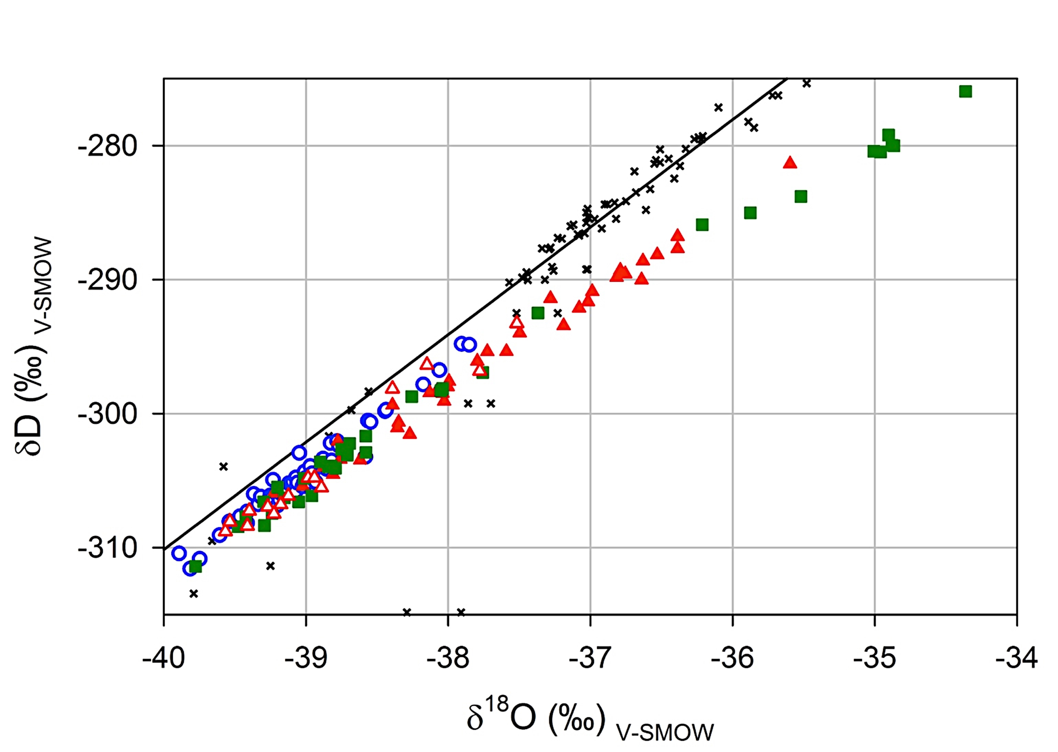
8. Tracking of M/R events @ NEEM BIL
✗
✗
M/R_{closed}
M/R_{closed}
HT DRILL
ROCK DRILL
S_{obs} = 6.90
Meteoric ✗
S_{obs} = 6.18
Meteoric ✗
Too high
Too high
Model : S_{fc} = 5.20
S_{fc} = 5.15
DRL
IDD

Slide 9
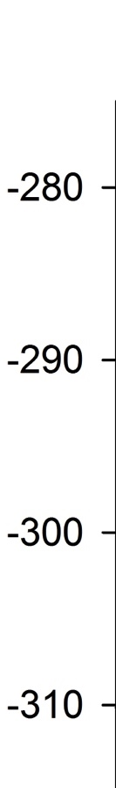
8. Tracking of M/R events @ NEEM BIL
M/R_{closed} ✔
HT DRILL
ROCK DRILL
S_{obs} = 5.62
Meteoric ✗
similar
Model :S_{fc} = 5.28
IDD

Slide 10
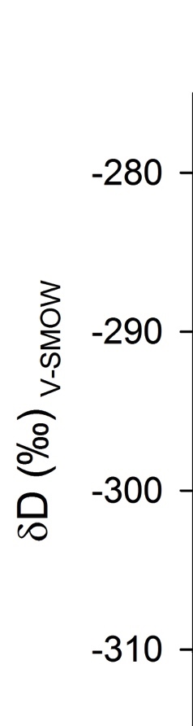
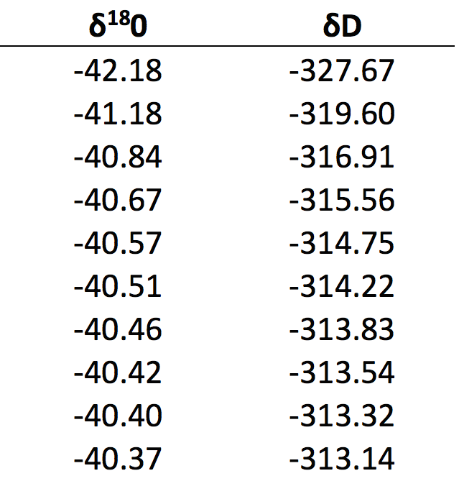
8. Tracking of M/R events @ NEEM BIL
M/R_{closed} ✗
S_{obs} = 6.45
HT DRILL
ROCK DRILL
S_{f} model (open)
S_{obs} = 6.45
Meteoric ✗
Too high
S_{fc} = 5.23
DRL
Required Input water values for S_{f open} = 6.45 in the range of the last 50 m above the basal ice
Dahl Jensen et al. 2013

Slide 11
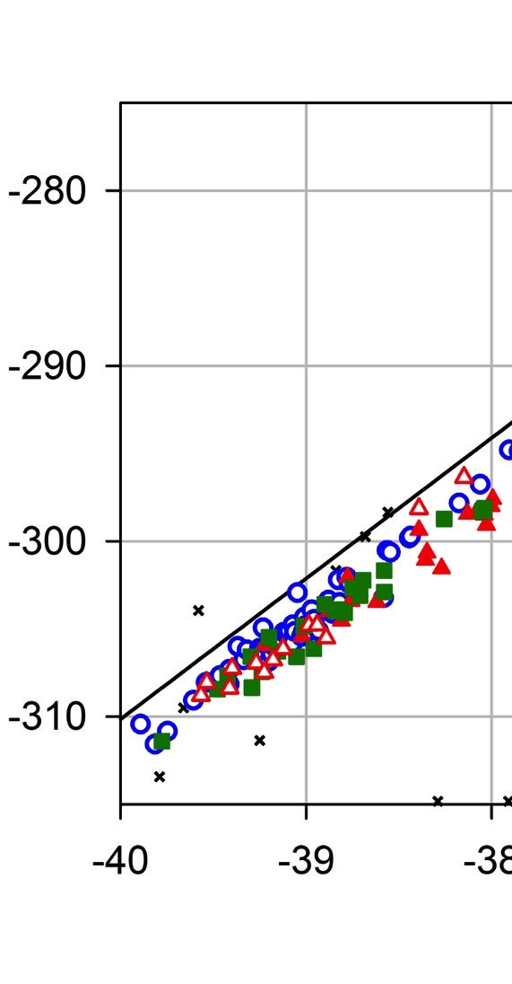
8. Tracking of M/R events @ NEEM BIL
HT DRILL
Dahl Jensen et al. 2013
S_{obs} = 7.52
Meteoric ✔
S_{obs} = 7.24
Meteoric ✔
meteoric
DRL
IDD
Sample
Refrozen
Sample
DRL
IDD
Dimmed isotopic M/R signal

Slide 12
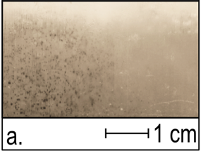
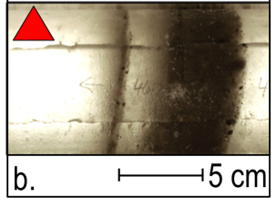

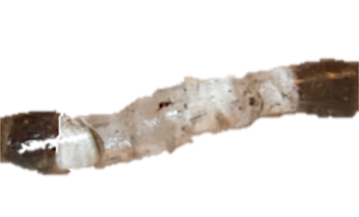
9. Possible scenario for the build-up of the NEEM BIL
Meteoric ice
No specks
ICE FLOW
Drilling
Large Scale Shearing
Isochrones
Small Scale Shearing
CIS
Gas expulsion
Melting
Refreezing
Debris
Frozen
sediment
Bedrock
Protuberance
CIS
DRL
IDD
IDD
meteoric
IDD
v
Meteoric
M/R open
Dimmed M/R
M/R closed

Slide 13
10. Conclusions
Description of a complete sequence from non-altered meteoric ice to frozen till
A Build up scenario for the NEEM BIL
Main features of the NEEM BIL :
Mean δ ¹⁸O value of the ice (⬄-36.8 °C) compatible with the existence of an extensive ice sheet at the time of its formation (>< GRIP BIL = relict ice).
A meteoric origin for CIS, preserved isotopic signal with however redistribution of impurities and gas depletion
A basal origin for debris-bearing ice, with a melting/refreezing signature potentially dimmed. Altered Isotopic signal and partial recovering of gas content in bottom IDD
A proof of the existence of a liquid phase at the ice/bedrock interface

Slide 14
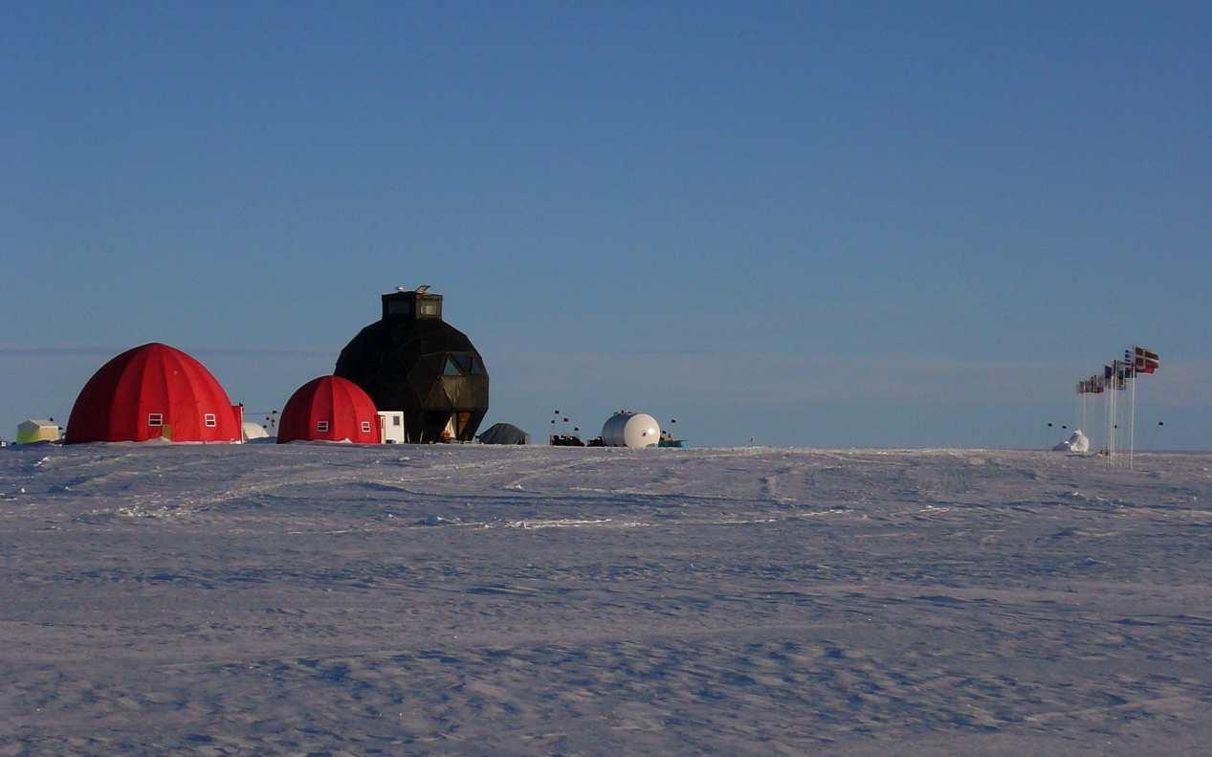
Thank you for your attention
Thanks to the NEEM community for the effort and the support in the present work
NEEM is directed and organized by the Center of Ice and Climate at the Niels Bohr Institute and US NSF, Office of Polar Programs. It is supported by funding agencies and institutions in Belgium (FNRS-CFB and FWO), Canada (NRCan/GSC), China (CAS), Denmark (FIST), France (IPEV, CNRS/INSU, CEA and ANR), Germany (AWI), Iceland (RannIs), Japan (NIPR), Korea (KOPRI), The Netherlands (NWO/ALW), Sweden (VR), Switzerland (SNF), United Kingdom (NERC) and the USA (US NSF, Office of Polar Programs).

